Slide 1
Probability Distribution

Slide 2
What is distribution?
Frequency distribution:
Binomial distribution
Poisson distribution
Normal Distribution

Slide 3
What is probability distribution?
If rolling a dice, probability of getting every single output is 1/6
P(1)=1/6
P(2)=1/6
P(3)=1/6
P(4)=1/6
P(5)=1/6
P(6)=1/6

Slide 4
Flipping a coin
P(H)=1/2
P(T)=1/2
Flipping two coins together/ flipping one coin two times
In above case what is the probability of getting zero heads.
1st event | 2nd event
H | H
H | T
T | H
T | T

Slide 5
Observation
When there are both occurrences of tail that means there are not head
From above observation table ¼ chance not to get head in both evidences
P(H,H)=1/4 = 0.25
Probability of getting one head is P(T,H) or P(H,T)
P(T,H) or P(H,T)=2/4 = 0.50
P(T,T)=1/4 = 0.25

Slide 6
Glimpse
If the same flipping coins or rolling dice event occurs many times then calculating probability will become a difficult task.
The same challenge can be handled using statistical concepts, software and coding.
The distribution graph will help to see the probability distribution.

Slide 7
Glimpse
Sum of the area under probability distribution is always 1.
Total probability is always 1.
Type of data can be discrete or continuous

Slide 8
Binomial
distribution

Slide 9
Properties
More and more experiments should be happened.
Each trial can result in just two possible outcome. Like success or failure , sing in or log out, accepted or rejected etc…..
Probability of success is denoted by p
Every trial is independent. That means it is not dependant on previous outcome.

Slide 10
Binomial distribution
Simply count number of event and Outcome of experiment is in two forms.
Gives probability of success out of total number of experiments
If P(w)=0.75 is probability for winning
P(l)=0.25 is probability for loosing
Then out of 5 events what is the probability to win ?

Slide 11

Binomial
K=number of successful event
Probability of successes
Out of 5 events what is the chance of success?

Slide 12
Formula for binomial probability
P(x)=ncx * p^x * (1-p)^(n-x)
P(x)= (n!/(x!(n-x)!)) * P^x *(1-p) ^(n-x)
X:number of success result from binomial experiment.
N: the number of trials in the binomial experiment.
p: The probability of success on an individual trial
P(x) the probability that n trial binomial experiments results in exactly x successes, when the probability of success on an individual trial is p.

Slide 13
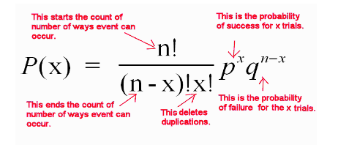
Formula

Slide 14
Example -1
If we are flipping 4 coins then what is the probability of getting 1 head?
P(x)= (n!/(x!(n-x)!)) * P^x *(1-p) ^(n-x)
P(1)= (4!/ 1! * 3! ) * 0.5*1 * (1- 0.5) ^(4-1)
P(1) = 4 * 0.5 * 0.5^3
P(1)=4* 0.5^4 = 0.25

Slide 15
Example-2
If win is 0 means losing of 5 matches ie. [L,L,L,L,L]
Probability is (0.25)**5
If 1 win event then Probability = (0.75)*(0.25)**4
Hence we can say
P(x=3)+P(x=4)+P(x=5)
The same can be done as
5C3*(0.75)**3*(0.25)**(5-3)
Outcome is the probability to win the series.

Slide 16
Example-3
Suppose a toy production company has 12% defect rate. Buyer decided to purchase after testing random 20 toys. Buyer will accept this if there are 2 or less defective toys. What is the probability of getting accepted?
p=0.12 , n = 20, x = 0,1,2
P(0) = 20!/(0!*(20-0)!) * 0.12^0 * (1-0.12)^(20-0)
P(1) = 20!/(1!*(20-1)!) * 0.12^1 * (1-0.12)^(20-1)
P(2) = 20!/(2!*(20-2)!) * 0.12^2 * (1-0.12)^(20-2)
P(o)= P(0)+p(1)+p(2) =0.563132

Slide 17
outcome
Once we are having binomial distribution, we can find out mean, variance and standard deviation of the distribution.
Mean= n*p
Variance = n*p*(1-p)
Standard deviation = sqrt(n*p*(1-p))

Slide 18
Poisson
distribution

Slide 19
Binomial vs. Poisson
Binomial | Poisson
Similarities:
1) Used for discrete distribution
2) Measures the number of success
Differences
Possibility of success is finite | Possibility of success are infinite
e.g. out of 20 defective toys 20 can be defective but not more than 20 | e.g. How many people are purchasing movie tickets

Slide 20
Properties
Experiment results in outcomes that can be classified as success or failure, true or false, yes or no etc…
Average number of success in the specific region is known.
Outcomes are random. Occurrence of one outcome does not influence the chance of another outcome of interest.
The outcome of interest is rare relative to the possible outcomes
E.g. Queue at the counter, road accident, etc

Slide 21
Poisson's distribution
outcome is in count, time or range
Poisson’s distribution is used when we want probability between time period.
E.g. how many of students will be placed?
How many fraud cases except to see?

Slide 22
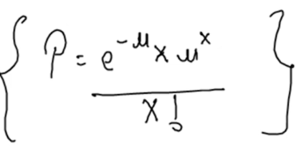
Suppose there are 10 cars/ hrs in garage then what is the probability that there are 100 cars/day
So here, we are considering hrs to calculate the probability for day.
e: a constant equal to 2.71828
µ: the number of success occurred in specific time interval or specific region
X: is number of success
P: P(x; µ): The Poisson probability that exactly x success occur in a poisson experiment when the mean number of success is µ.

Slide 23
Example 1
On a booking counter on the average 3.6 people come every 10 minutes on weekends. What is the probability of getting 7 people in 10 minute?
µ= 3.6
X= 7
P(X, µ)=(e^-3.6 )* (3.6^7)/7!
P(X, µ)=0.02732*7836.41/5040
P(X, µ)=0.0424
This means 4% chance of getting 7 people in 10 minute

Slide 24
Example-2
Real estate company is selling 2 flats/ day what is the probability that company will sell 3 flats/days
Here µ = 2 and x = 3 is the goal
After using the formula is gives probability as 0.18

Slide 25
Observation
The mean of distribution is µ
The variance is equal to µ

Slide 26
Normal
distribution

Slide 27
Properties
Continuous data
Normal distribution is symmetric
Long tail, bell shaped
Mean, median/mode are same
Shape of the curve defined by
Mean
Standard deviation

Slide 28
Properties
If we have skewness in data set tail of the data is not distributed evenly.
The probability of any particular value is 0
The probability that X is greater than or less than a value = area under the normal curve in that direction
For normal distribution of the data
mean and variance could be any value
range is from -∞ to + ∞
Entire area = 1

Slide 29
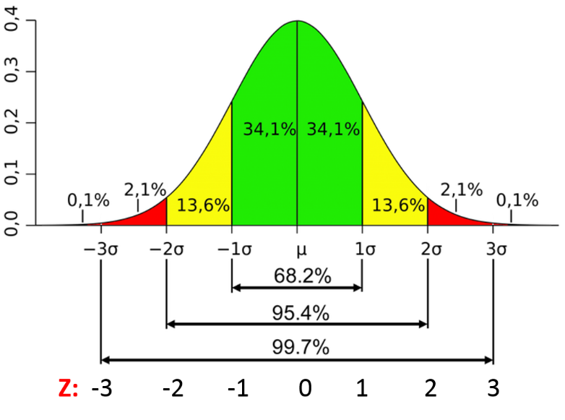
Normal distribution shows the bell shape curve

Slide 30
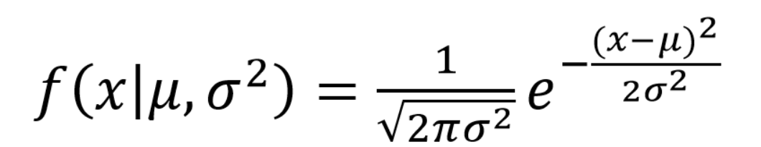
Normal Distribution
Most occurring distribution
Standard normal distribution is also known as z-distribution
Equal amount of data on both sides then we call is as balanced data set
ML algorithm is trained based on normally distributed algorithm
Formula to find probability of single value is

Slide 31
Formula explained
µ: mean
σ: standard deviation
π: 3.14159
e: approximately 2.71828
For z-distribution µ =0 and σ = 1

Slide 32
Z-value
Z-value is also known as standard score
Z = (x-µ )/σ
A bottle is having average volume as 150cc and the standard deviation is 2 cc. What percentage of bottles will have volume more than 153 cc
µ =150cc
σ = 2cc
Z=(153-150)/2 = 1.5
Hence z-score is 1.5
Probability of area selection is 0.9332
More than 153 bottles are 1 – 0.9332 = 0.06680 = 6.6%

Slide 33
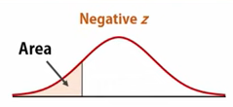
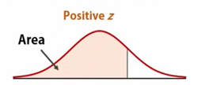
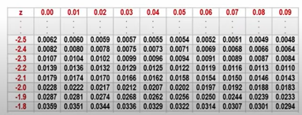
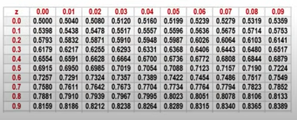
Z score
Normal distribution calculating probability
Area under normal curve is 1

Slide 34
Example-1
Scores in an exam are normally distributed with mean 65 and standard deviation of 9. find the percent of the score.
Less than 54
At least 80
Between 70 and 86

Slide 35
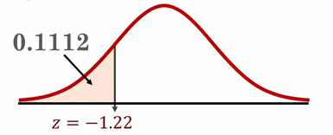
Less than 54
This means P(x<54)
Z= (x-µ )/σ = (54-65)/ 9 = -1.2222
Check in the negative z-score for row with -1.2 and column 0.02
Corresponding area is 0.1112 i.e. Area to the left of z=-1.222 is 0.1112
P(x<54)= P(z< -1.222) = 0.1112 =11.12%

Slide 36
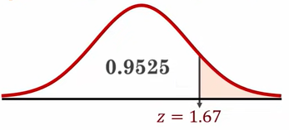
At least 80
P(x>=80) = P(x>80)
Z= (x-µ )/σ = (80-65)/9 = 1.67
In z table, check 1.6 against 0.07 equal to 0.9525
P(x>80)> P(z>1.67) = 1- 0.9525 = 0.0475 = 4.75%

Slide 37
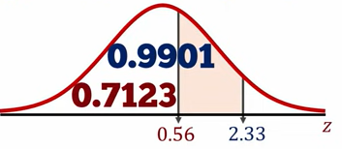
Between 70 and 86
Z= (x-µ )/σ
For x=70
Z=(70 – 65)/9 = 0.56
In z table, check 0.5 against 0.06 equal to 0.7123
For x = 86
Z= (86-65)/9 = 2.33
In z table, check 2.3 against 0.03 equal to 0.991

Slide 38
Between 70 and 86
Finding the are between two z values from cumulative table is subtracting from large amount
P(70 <x < 85) = P(0.56 < z < 2.33)
= P(z < 2.33) - P(z<0.56)
=0.9901 -0.7123
=0.2778 = 27.78%

Slide 39
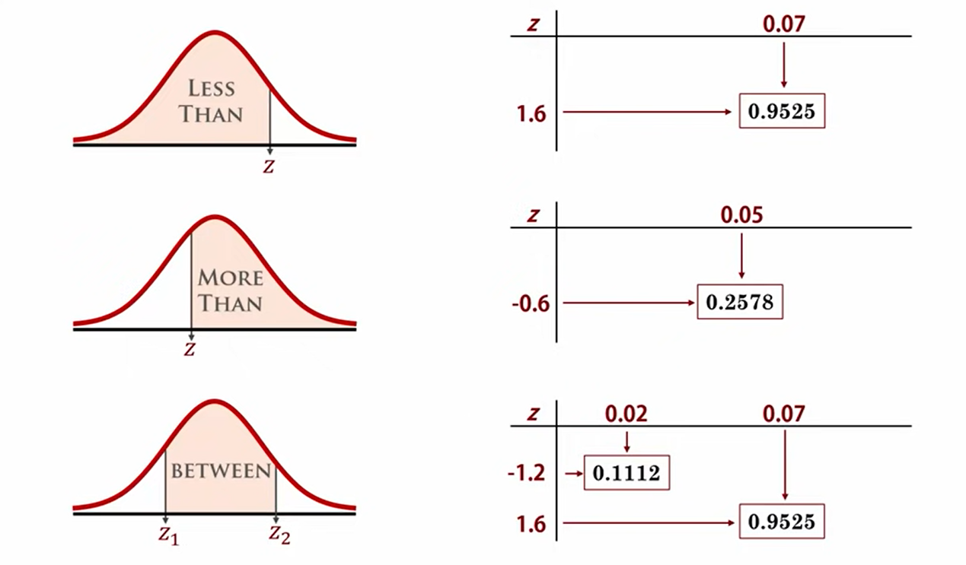
Summary

Slide 40
Example 2
Perfume bottle filled with the average volume of 150 cc and the standard deviation of 2 cc.
What percentage of bottles will have the volume between 148 and 152 cc?
Z= (x-µ )/σ
Here µ = 150 cc and σ= 2cc
Z1=(148-150)/2 = -1
Z2 =(152 – 150)/2 = 1
P(x)=1 – 0.1587 – 0.1587 = 0.6826

Slide 41
Thank you

